Slide 1


CAPSTONE
PROJECT
PYTHON
Name : Khushi Manoj Ojha
Id : S9730

Slide 2


www.reallygreatsite.com
OTP VERIFICATION SYSTEM
“A Shield Against Cyber Crime"

Slide 3
LIST OF CONTENTS
www.reallygreatsite.com
Title
02
Cyber Crime V/S Digital Security
04
Project Overview
05
Program
06
Challenges & Solutions
12
Conclusion
13

Slide 4

HACKER
ANTI-VIRUS
VIRUS
FIREWALL
FRAUD
BACKUP
DATA BREACHER
VPN
SCAM
IDENTITY THEFT
MALWARE
TWO-FACTOR AUTHENTICATION
AUTHENTICATION

Slide 5



Project Overview
Designed to combat unauthorized access, the OTP ensures a secure login process, adding an additional layer of protection.
The project integrates email communication, OTP generation, and user input validation to ensure reliable and fast authentication.
With user-friendly prompts and error handling, this OTP system is designed to be both secure and easy to use.

Slide 6
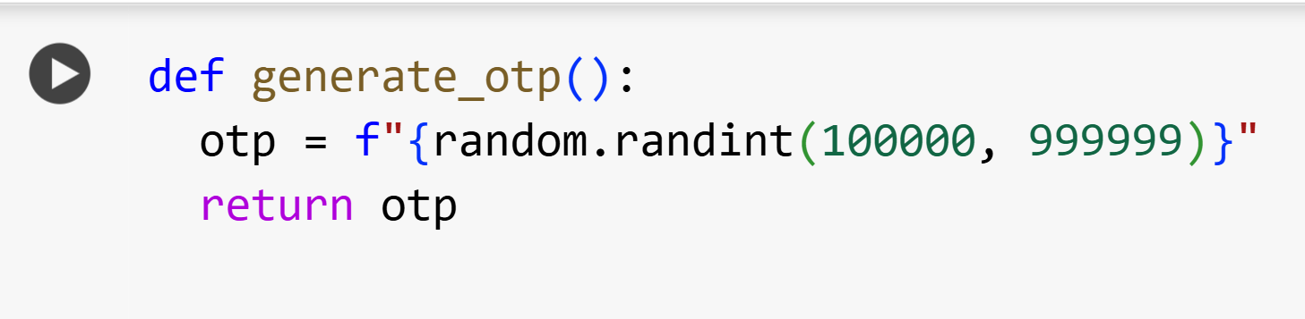
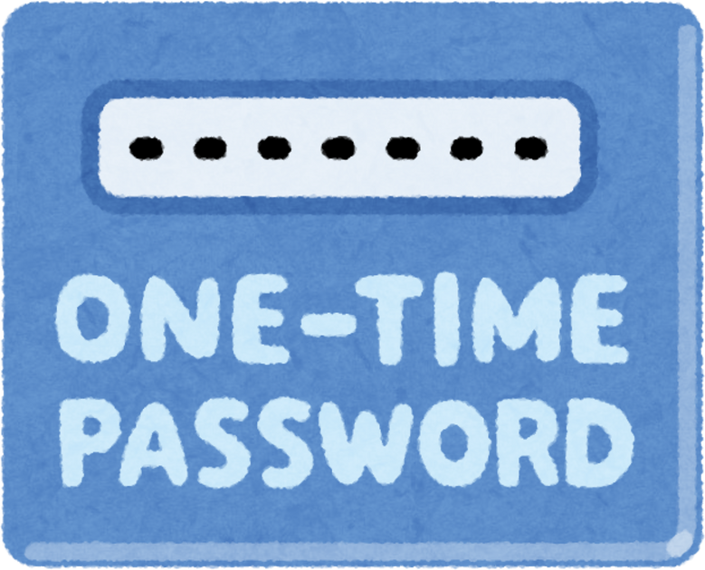
OTP Generation

Slide 7
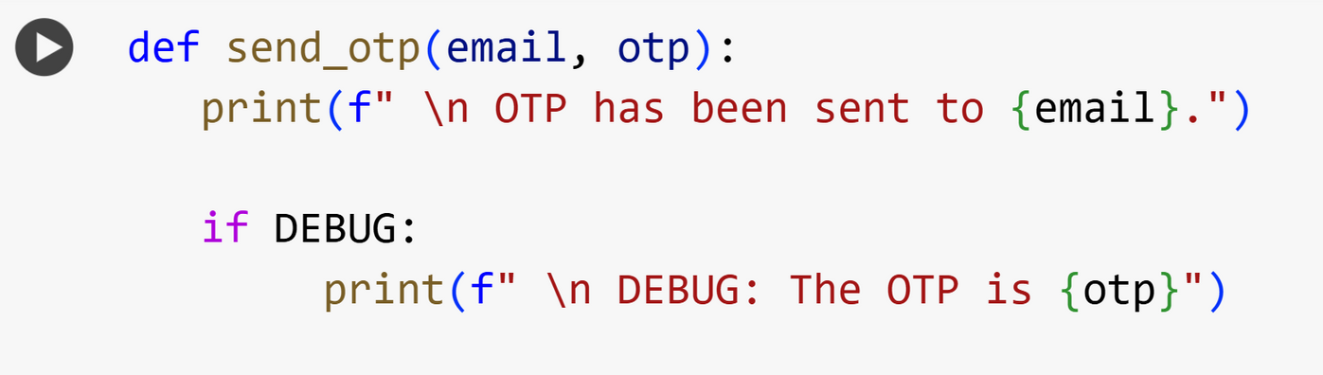

Sending OTP

Slide 8
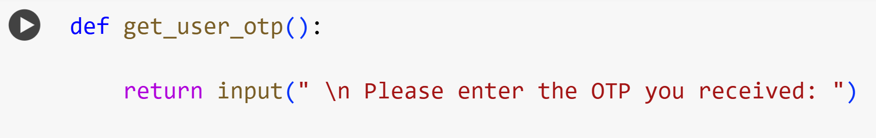

User Input

Slide 9
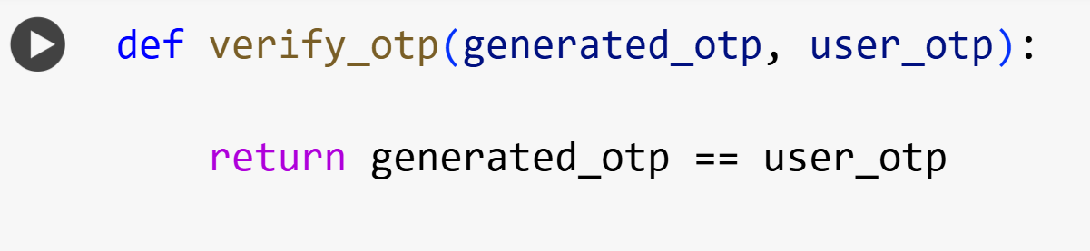

Validation

Slide 10
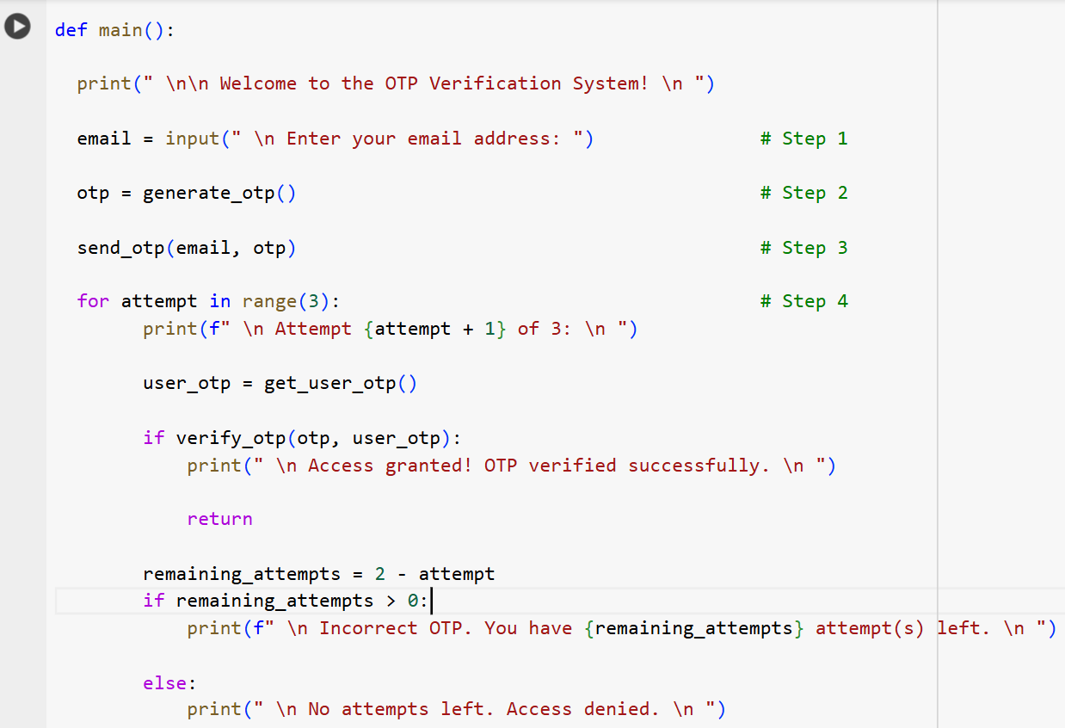
Main Program

Slide 11
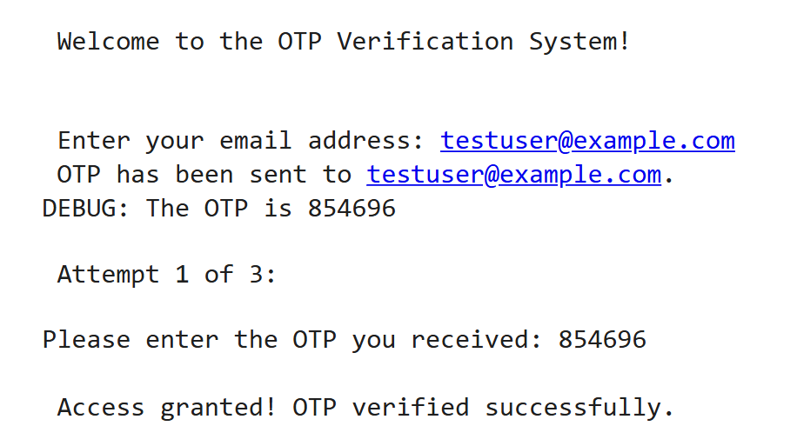
Output

Slide 12



Challenge
Solution
Users may enter an incorrect OTP multiple times
Implemented a retry mechanism with a limited number of attempts
Users need to be clearly informed of errors
Provided user-friendly messages such as "Access granted!" or "Incorrect OTP”
The OTP must be exactly 6 digits long
If the OTP is not 6 digits, prompt the user to re-enter it correctly.

Slide 13


A reliable 6-digit OTP system to ensure only authorized access.
Conclusion
Clear instructions, retries, and error handling for smooth user experience.
Easy to integrate into various platforms to strengthen security.
Adds an extra layer of protection against unauthorized access.
"Let’s Secure the Web Together!"

Slide 14


THANK YOU!
www.reallygreatsite.com

